Slide 1
Using AWS for Research Computing

Slide 2
Goals
Augment the research computing capabilities for Booth faculty by extending into Amazon Web Services “cloud” for on-demand computing.

Slide 3
Business Requirements
Allow faculty to log in to AWS using either their CNET or Booth ID.
Single Sign-On via CNET is preferred.
Seamless access to AWS resources, they should act like local services.
Charge back AWS costs to individual faculty RATS accounts.
Provide the ability for IT to quickly (within 24 hours) provision AWS resources within a faculty member’s environment. Self-provisioning by faculty is an option but with controls.
Provide the ability to provision both AWS resources as well as common statistical applications (e.g. Matlab, Stata, etc.)
Will need to take into account license management from an off-campus source.
Offer service catalog to faculty only displaying the services they have permission to use.

Slide 4
Technical Requirements
Reuse as much existing infrastructure, such as AD, Puppet, Splunk, Isilon as possible.
Leverage AWS IAM groups, coupled with the SSO repsonse, to provide access control to specific services.
The services to offer at the beginning are: EC2, S3, EBS and Elastic IP‘s.
Use AWS tags to control access and provide chargeback information.
Connect the Booth data centers to AWS VPC’s over IPSec using our existing data center ASA firewalls.
Extend campus routable subnets, provided by ITS, into all AWS services providing for both on and off campus routing.

Slide 5
Known Issues
Tags cannot be created under our DLT linked account, they can only be created by DLT under their “payer” account.
DLT has created some under their account for use by all linked accounts.
AWS budgets cannot be created under a linked account.
Detailed bills cannot be downloaded under our DLT linked account.
AWS cost explorer cannot be used under our DLT linked account.
AWS cost and usage reports cannot be viewed under our DLT linked account.

Slide 6
Questions
Can we obtain an account for Booth that’s not linked to the DLT payer account and still get the Internet2 discounts?
Can we leverage an AWS architect to determine what parts of AWS infrastructure would be suited to our requirements?

Slide 7
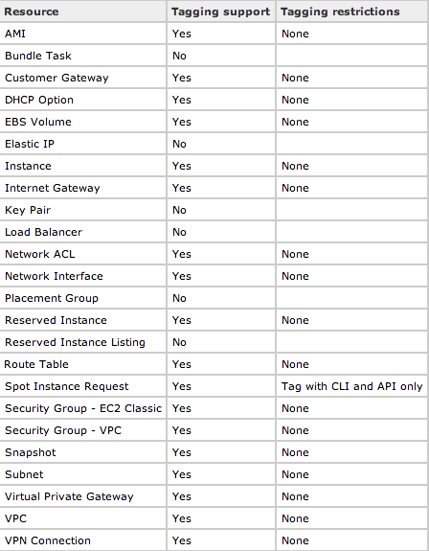
AWS Tags

